Slide 1

DC Adventures in Python API Integration
Miriam Heller
February 20, 2019

Slide 2
On your mark, get set...
WIFI info
Network:
Password:
Have up and running
Python 2.7 or higher
Preferably jupyter notebook or your favorite IDE
Clone/download from GitHub:
xxxx
Xxxx-answers for later validation
Download Postman app (preferred)
https://www.getpostman.com/downloads/
Good references

Slide 3
Python API Integration: Lab Exercise
Choose API of interest: Programmable Web
Go to web server data of interest (e.g., IMDB)
Dissect the data structure on the server
Generate API Key if necessary
Use Postman app to test data request
Write Python code to extract data from web server and parse it out into a readable form
Use data in useful Python Code
Try this yourself for an API I give you or one of your own choosing

Slide 4
Definitions: Don’t Try APIs Without Them
HTTP Request and Response Cycle
Static Assets and Databases
Endpoint
HTTP Methods
HTTP Status Codes
API
API Key
JSON
Notes:
HTTP Requests and Responses
Static Assets and Databases
Endpoint
HTTP Methods
REST
HTTP Status Codes
API
Authentication
API Key
JSON

Slide 5
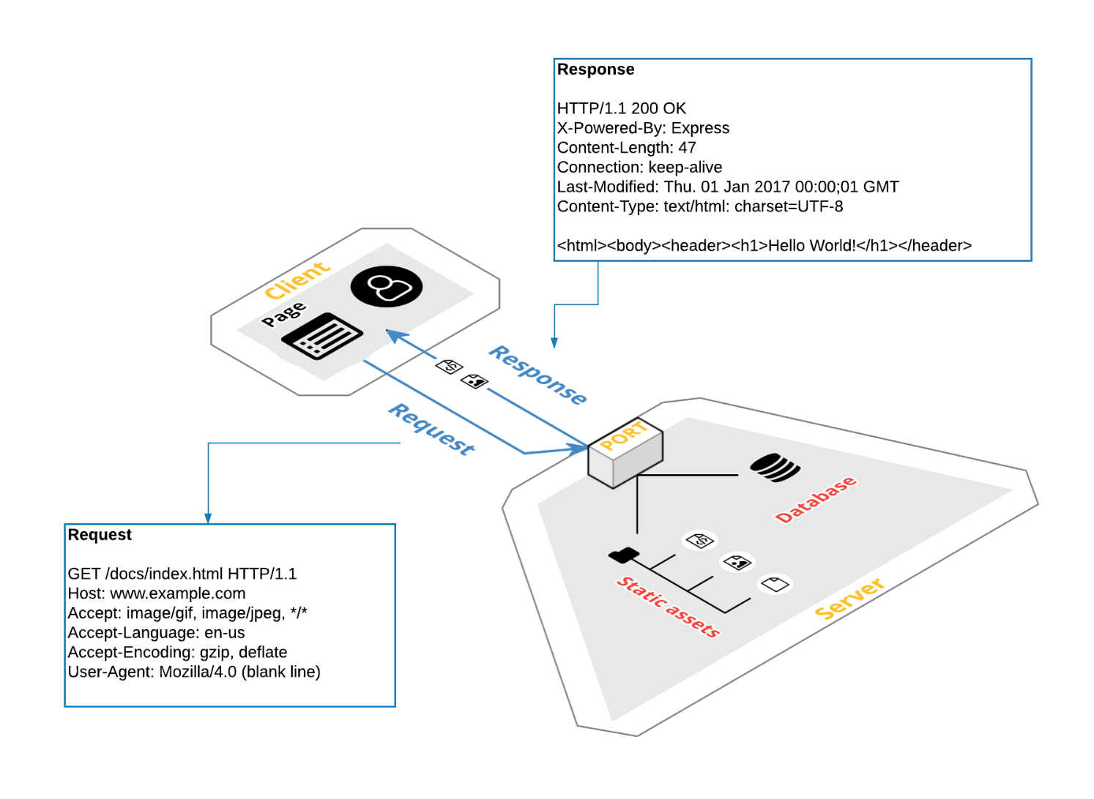
Webscraping vs API Integration: Client vs Server
Web servers and clients speak HTTP to each other
Source: Thinkful curriculum, 2018
Notes:
Animated slide – run to view
HTTP Request Response Cycle:

Slide 6
What’s an API?
API = Application Programming Interface
Server-side code that “exposes resources”
files (html/css, and data

Slide 7
Online Resources: PYTHON API
Programmable Web: https://www.programmableweb.com/api-university/what-are-apis-and-how-do-they-work
HTTP Tutorial: https://www.tutorialspoint.com/http/

Slide 8
References for Python API Integration
A Byte of Python downloaded on 10/3/2018 from https://python.swaroopch.com/ through a Creative Commons Attribution-ShareAlike 4.0 International License.
Henn, Steve. (October 21, 2014). When Women Stopped Coding, National Public Radio, Morning Edition.
Jaschik, S. (June 25, 2018). Furor on Claim Women's Choices Create Gender Gap in Comp Sci, Inside Higher Ed, accessed 10/16/2018 from https://www.insidehighered.com/news/2018/06/25/lecturers-explanation-gender-gap-computer-science-it-reflect-womens-choices .
Requests for Humans: Python Developer Interface. Accessed 2/2/2019 from http://docs.python-requests.org/en/master/api/.

Slide 9
Explanatory and Extra Slides

Slide 10
About Women Who Code
WWC, established in 2011, is an international non-profit organization that
Helps women enhance their technical skills by providing study groups, meetings, training and scholarships
Connects our community with influential tech experts and investors through jobs boards and networking events
Offers career and leadership development
Increases female speakers & judges at conferences and hackathons
Enhances participation in the tech community
Publishes the weekly CODE Review
WWC boasts 137,000 members in 60 cities across 20 countries [WWC, 2018]

Slide 11
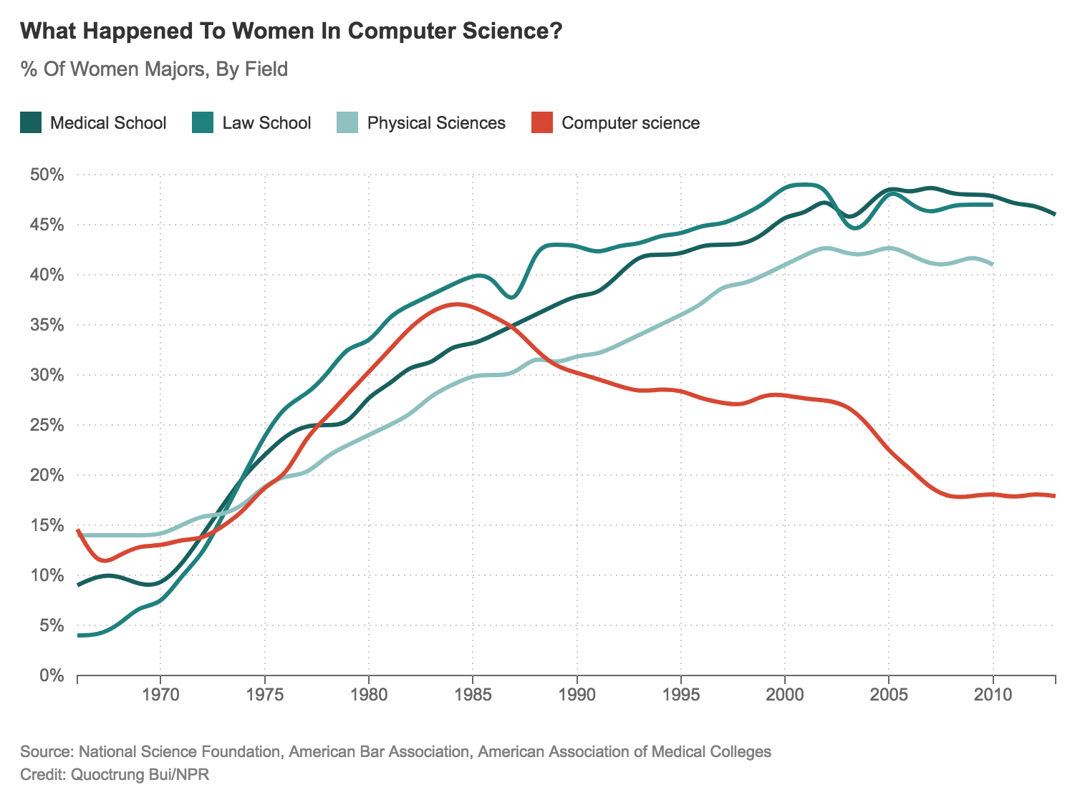
Why WWC?
Jaschik, S. (2018)

Slide 12
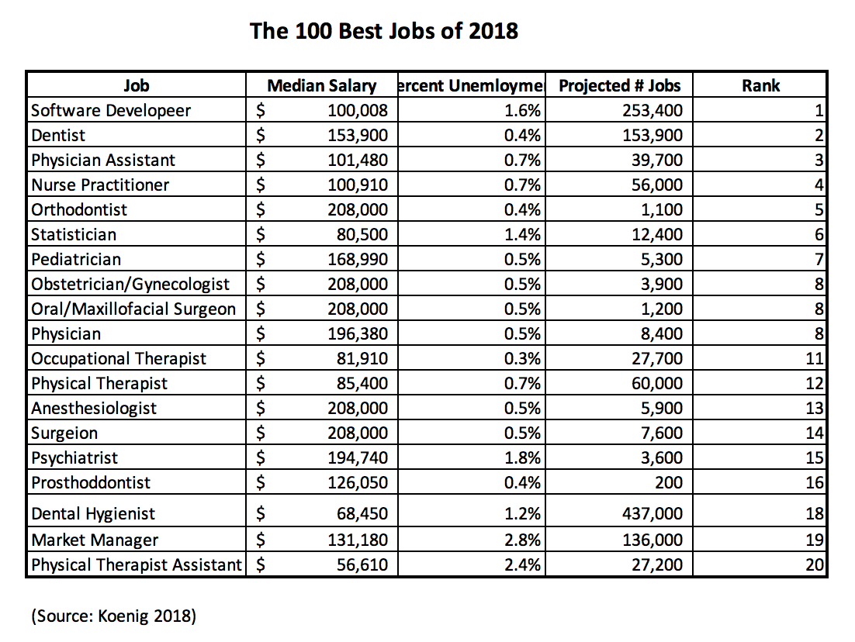
Why Separate WWC?

Slide 13

Abstract Data Types
Abstract data types are not data structures, but rather
Notions of how code will behave without specifying implementation or programming language
E.g., stacks and heaps must be able to:

